Slide 1


District Counselor Meeting
Inspire
Inspire
October 26, 2023

Slide 2

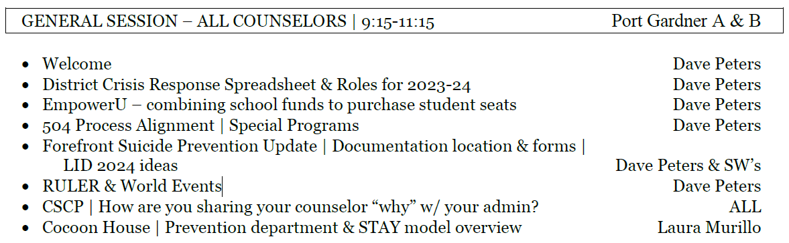
Today’s Agenda

Slide 3

Reflections from Yesterday…

Slide 4

Benefits of Being Present | Breathing
https://youtu.be/RVA2N6tX2cg?si=_YwpVVDyjx9Zi6Tq

Slide 5
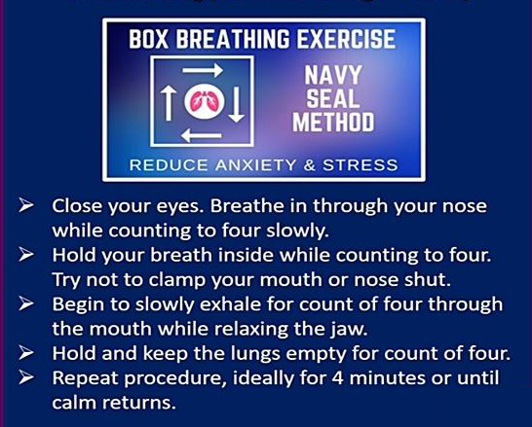

Benefits of Being Present | Breathing
Anxiety due to fear of the unknown
Dwelling on memories of negative experiences
5

Slide 6

Benefits of Being Present | Breathing
Jocko Willink | Navy Seal Team 3 Commander
https://youtu.be/u9LUM-UCwZs?si=tQC2krTRbwsSJZBg&t=162

Slide 7

Compassion & Resilience
https://youtu.be/MnHI7NOgyXo

Slide 8

Compassion & Empathy
https://youtu.be/QT6FdhKriB8?si=6qFznC4v494abtSY

Slide 9
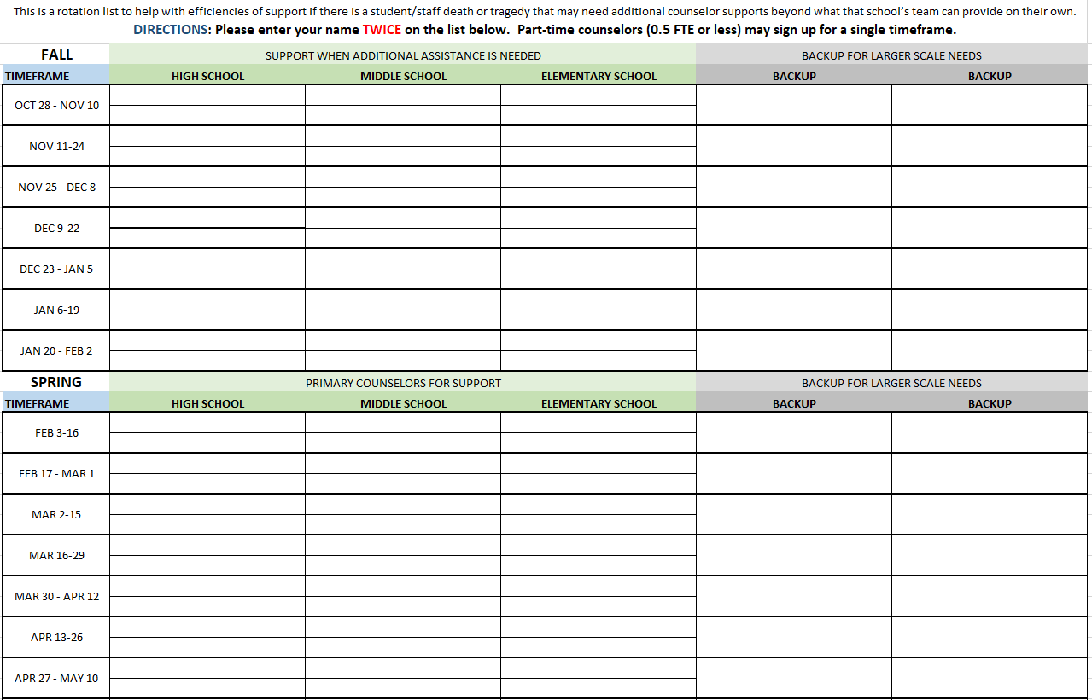
Crisis Response Support List
Click Here to Access

Slide 10

EmpowerU | Options for 2023-24
Sadly, EmpowerU was one of our budget casualties (funded with the ESSER Covid Relief dollars). We don’t yet have the budget capacity to purchase seats with them centrally. That said, here are the potential option for purchasing seats:
They will sell us student “seats” in groups of 10
  $370 per student, $3700 for 10
Schools can go in together to buy a few seats each to get to a total of at least 10 if their budget allows
We will re-evaluate the central budget this spring to see if we can pull together funding for some summer seats
Let me know if you have ideas or questions – or if you know of other schools that want to combine funding to purchase seats together.

Slide 11


Title here

Slide 12
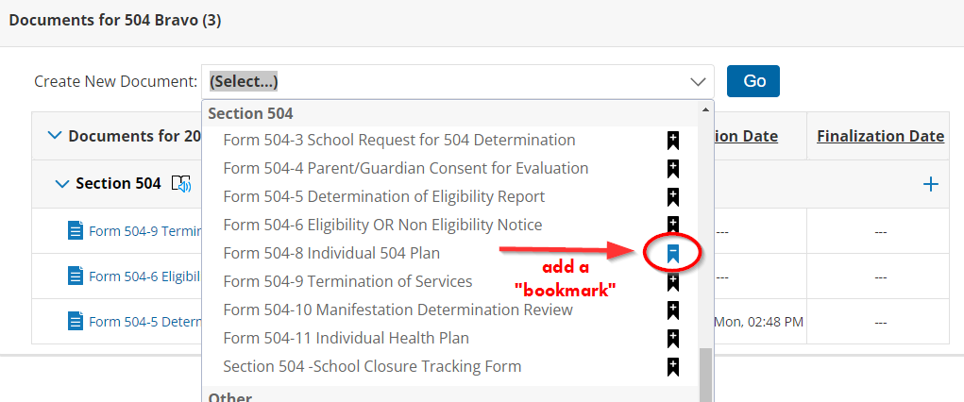
Title here
PRO TIP
You can add a bookmark to frequently accessed forms
12

Slide 13
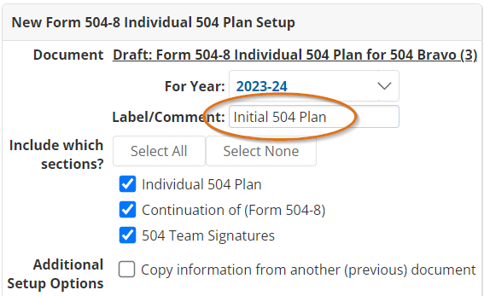
Title here
PRO TIP
Use a descriptive title
Initial 504 Plan
Annual Review
3-Year Re-Evaluation
Temporary 504

Slide 14
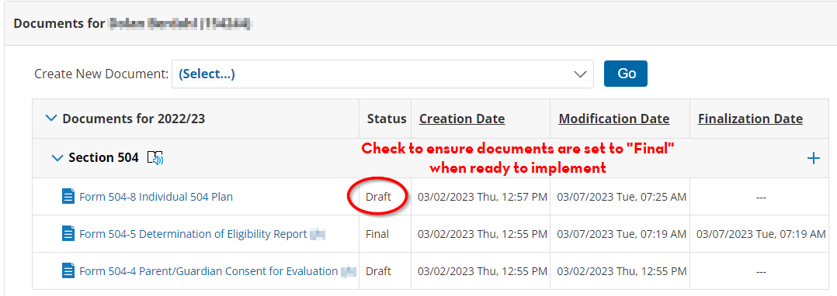
Title here
PRO TIP
When the 504-8 is set to “final”
The plan will appear in TAC and eSchool
It can be pulled and uploaded into TIDE (for testing accommodations)

Slide 15

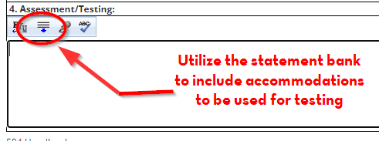
Title here
PRO TIP
In the Assessment/Testing Section you must choose from the preloaded SBA accommodations in order for the accommodation to be pulled into TIDE
Custom-worded testing accommodations will not be uploaded to the state database

Slide 16
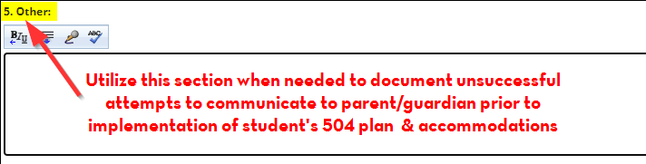
Title here
PRO TIP
Consent to evaluate is a required parent/guardian component, and parents/guardians must be notified of the 504 placement decisions, accommodations, and plan review

Slide 17
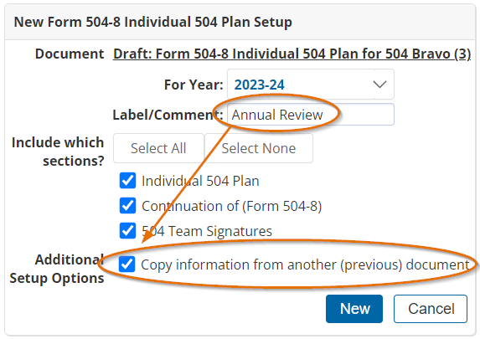
Title here
PRO TIP
For an annual review, you have the option of copying the current finalized 504 plan and making edits as appropriate or indicating no changes are necessary.

Slide 18
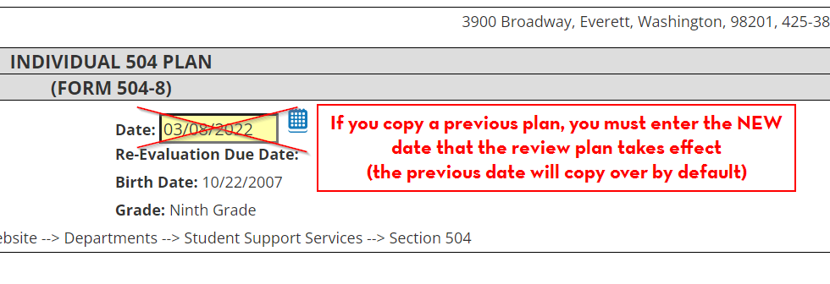
Title here
PRO TIP
From the copied plan, replace the previous date with the date the 504 review was completed

Slide 19
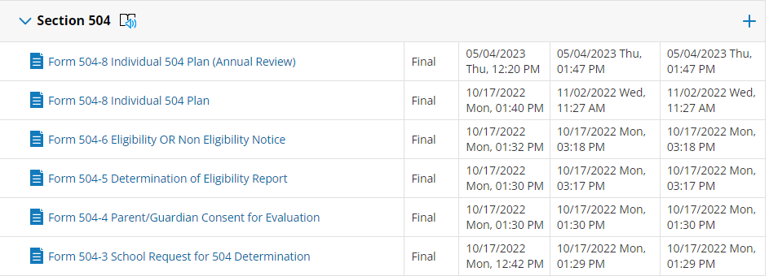
Title here
EXAMPLES TO CONSIDER
If this student transferred to your school, would you be more/less likely to understand the basis for the 504 and the student’s needs?

Slide 20
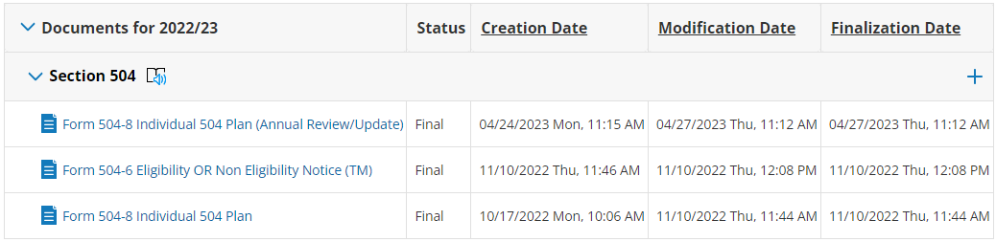
Title here
EXAMPLES TO CONSIDER
What’s missing?
Why are the missing elements important?

Slide 21
Title here
EXAMPLES TO CONSIDER
If this student transferred to your school, would you be more/less likely to understand the basis for the 504 and the student’s needs?

Slide 22
Title here
EXAMPLES TO CONSIDER
If this student transferred to your school, would you be more/less likely to understand the basis for the 504 and the student’s needs?

Slide 23

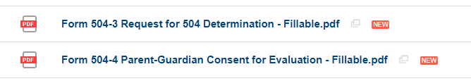
Title here
New Forms
Fillable PDF’s that parents/guardians can use:
Form 504-3 Request for 504 Determination
Form 504-4 Parent/Guardian Consent for Evaluation
In the 504 Docushare Folder

Slide 24
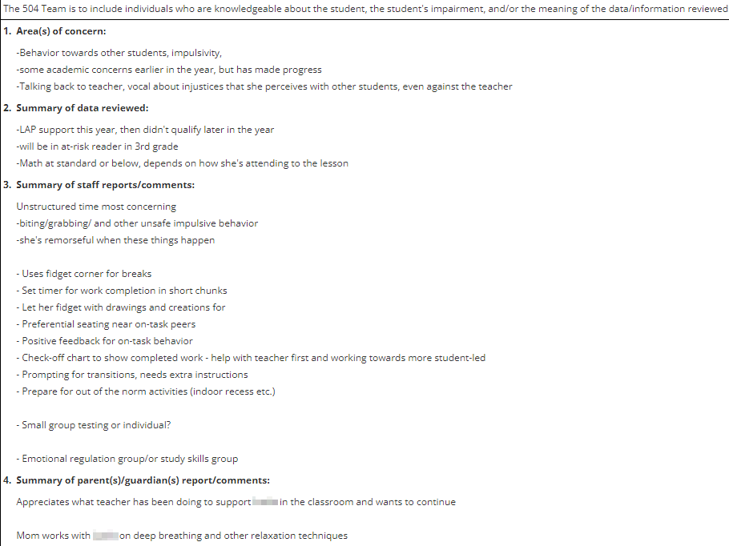
Title here

Slide 25
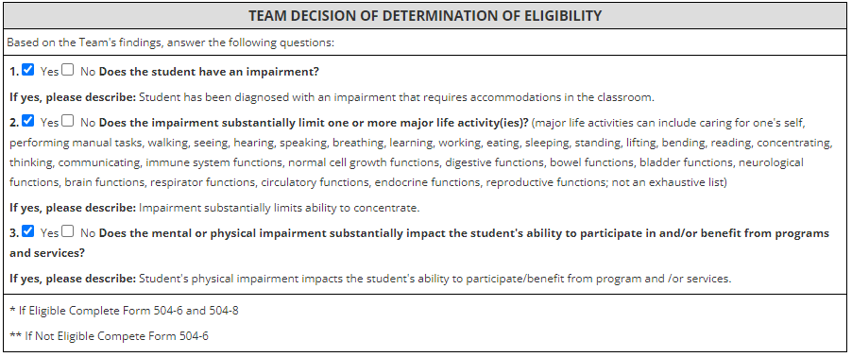
Title here

Slide 26

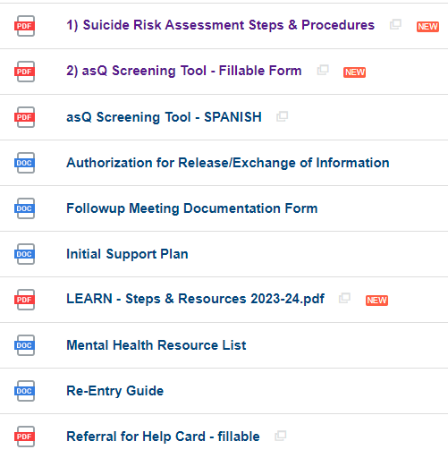
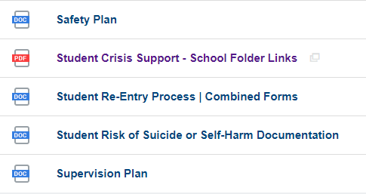
Title here
New Forms

Slide 27
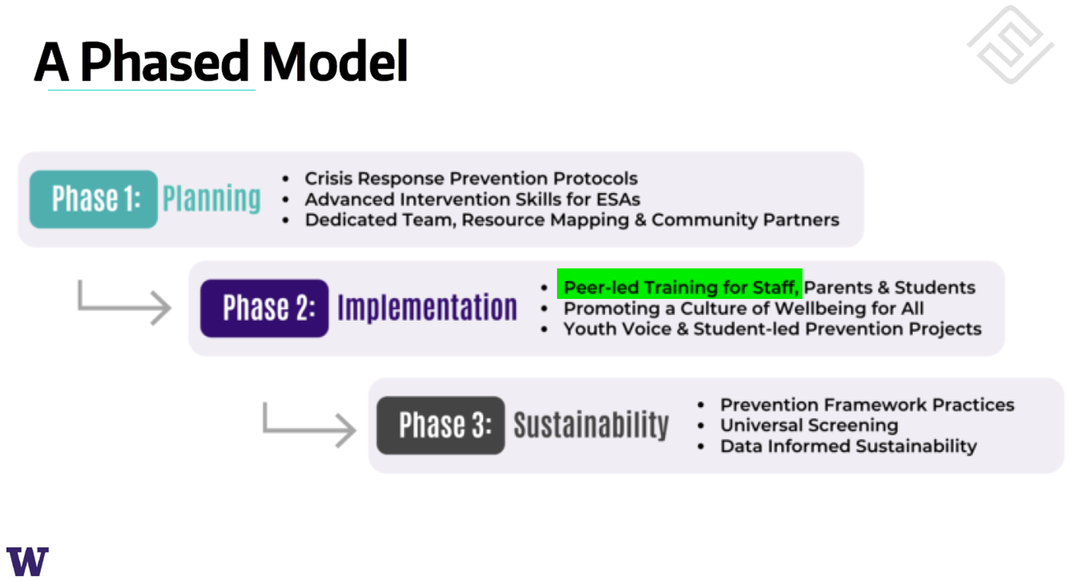
Learning Improvement Day | October 2024
You all teach LEARN on the Oct LID 2024

Slide 28


Current World Events
The Blueprint is a problem-solving tool for working with interpersonal conflicts. The Blueprint can be used independently or collaboratively to enhance empathy and identify effective solutions for past, real-time, or anticipated conflicts.

Slide 29
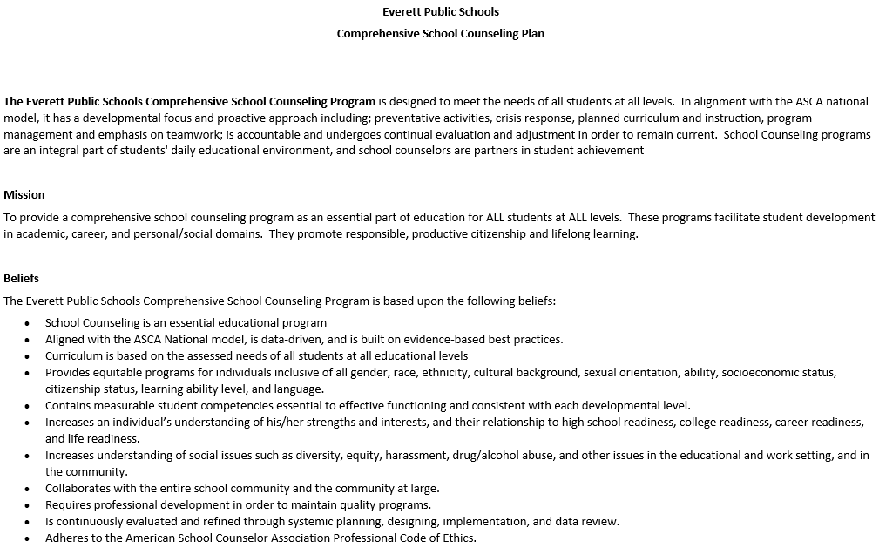
CSCP | Considerations for Next Steps

Slide 30

CSCP | Considerations for Next Steps

Slide 31

Prevention Department & STAY Model Overview
Laura Murillo
Bilingual Family Education Advocate

Slide 32
Elementary Counselor Meeting
Inspire
Inspire
October 26, 2023

Slide 33
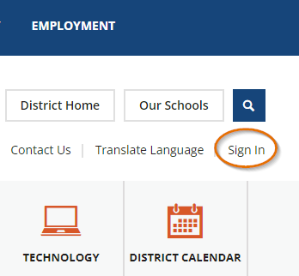


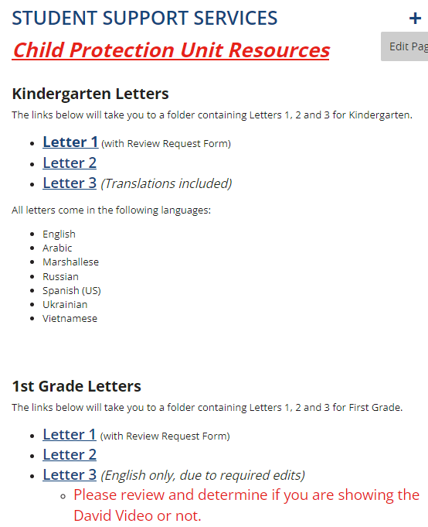

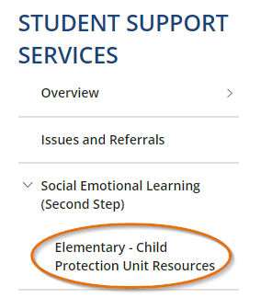

Child Protection Unit | Family Letters

Slide 34
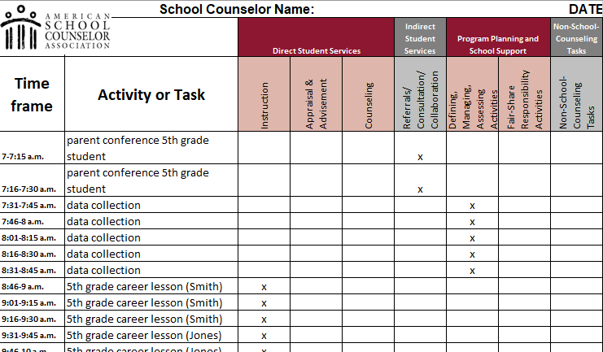
CSCP | Use of Time Calculator Options
https://www.schoolcounselor.org/getmedia/58cf104d-f75c-4e6a-bff6-4375f145b812/Use-of-Time-5-Day-Calculator.xlsx
34

Slide 35
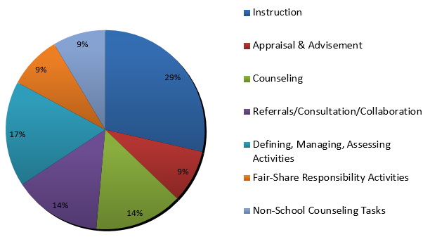
CSCP | Use of Time Calculator Options
https://www.schoolcounselor.org/getmedia/58cf104d-f75c-4e6a-bff6-4375f145b812/Use-of-Time-5-Day-Calculator.xlsx
35
35

Slide 36


CSCP | Principal-Counselor Relationship
https://www.schoolcounselor.org/getmedia/ccee1126-c1b7-40e4-b5d0-bae3c8262833/Enhancing-Principal-School-Counselor-Relationship.pdf
36
36
36

